Slide 1

Introduction to W 7 ITIN
In this presentation we will step through filling out your W 7 form which is to get you an ITIN.
ITIN is the acronyms' for Individual Taxpayer Identification Number
IRS (Internal Revenue Service) in the States serves the same purpose as the ATO in Aust.
IRS website is irs.gov

Slide 2
Getting an ITIN
Allow 8 – 10 weeks to receive your ITIN
  If you have not received your ITIN or correspondence by that time you can contact the IRS by telephone (– see Telephone Help later in this presentation)
Post W7 to:
  Internal Revenue Service
  ITIN Operation
  P.O. Box 149342
  Austin, TX 78714-9342

Slide 3
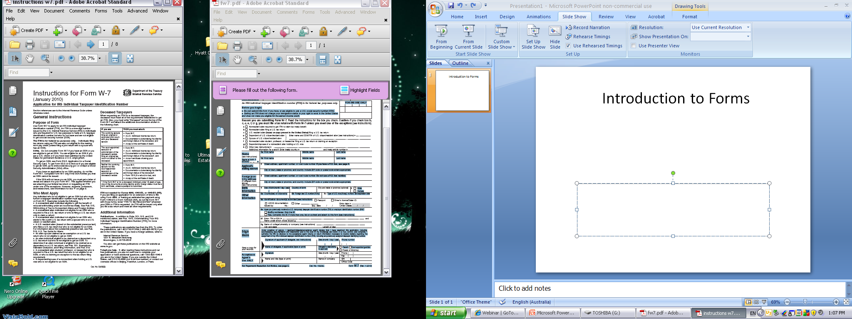
Introduction to Forms

Slide 4
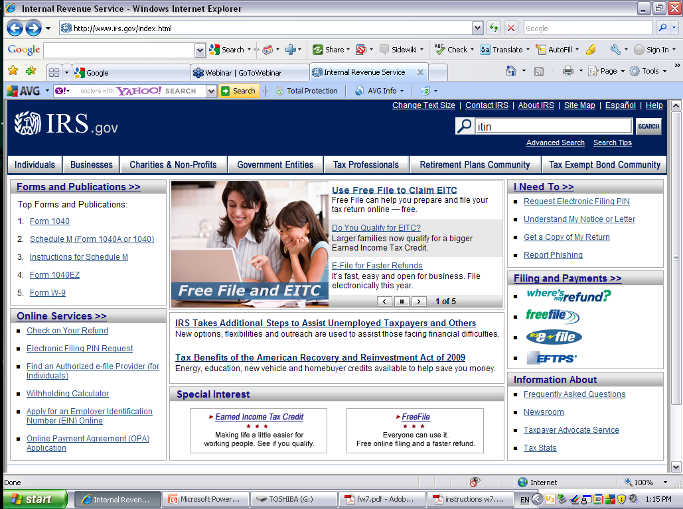

Slide 5
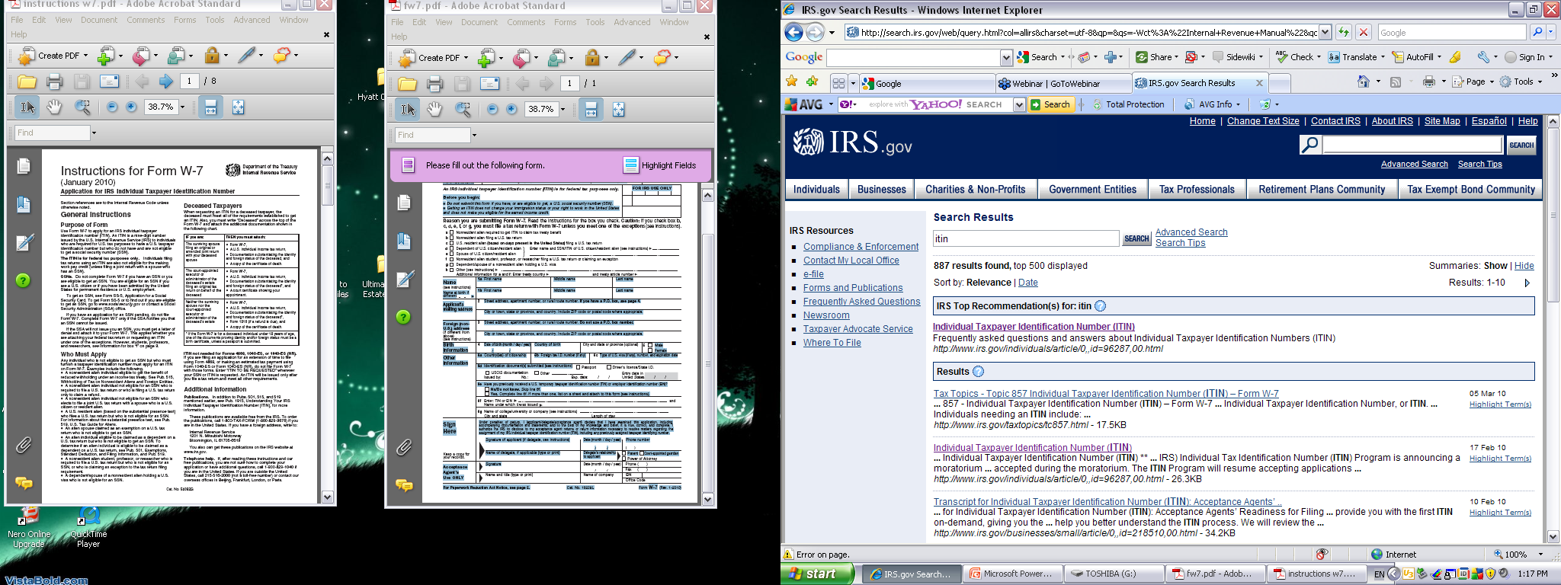

Slide 6
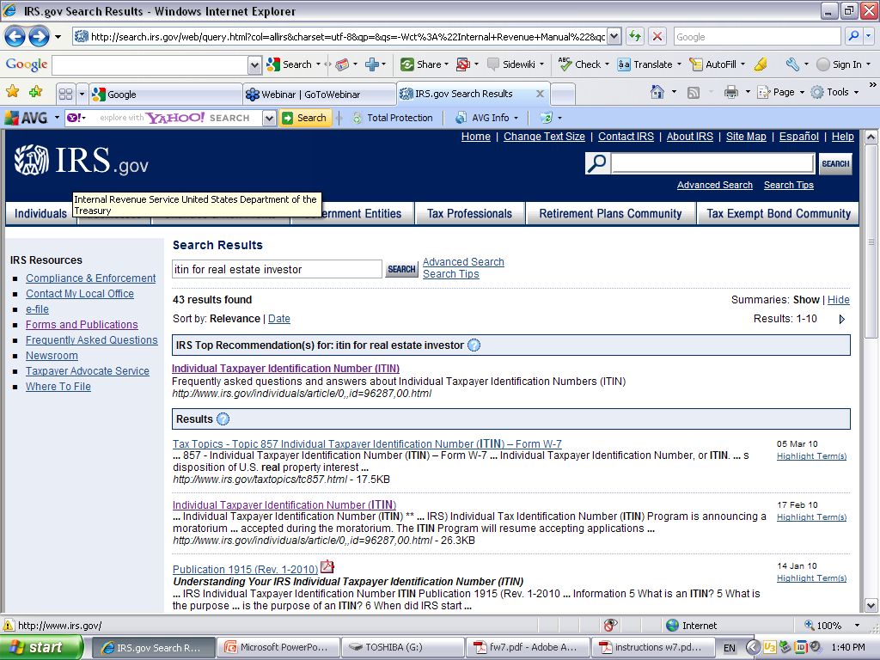

Slide 7
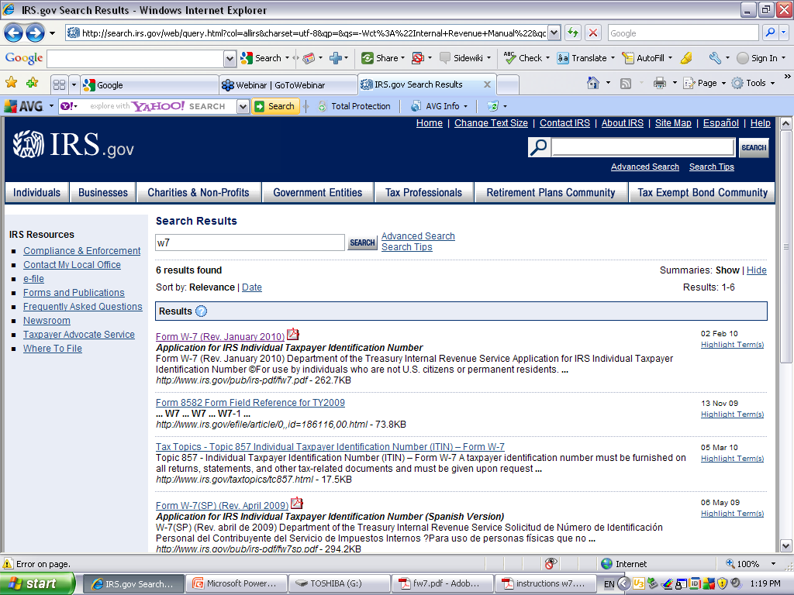

Slide 8
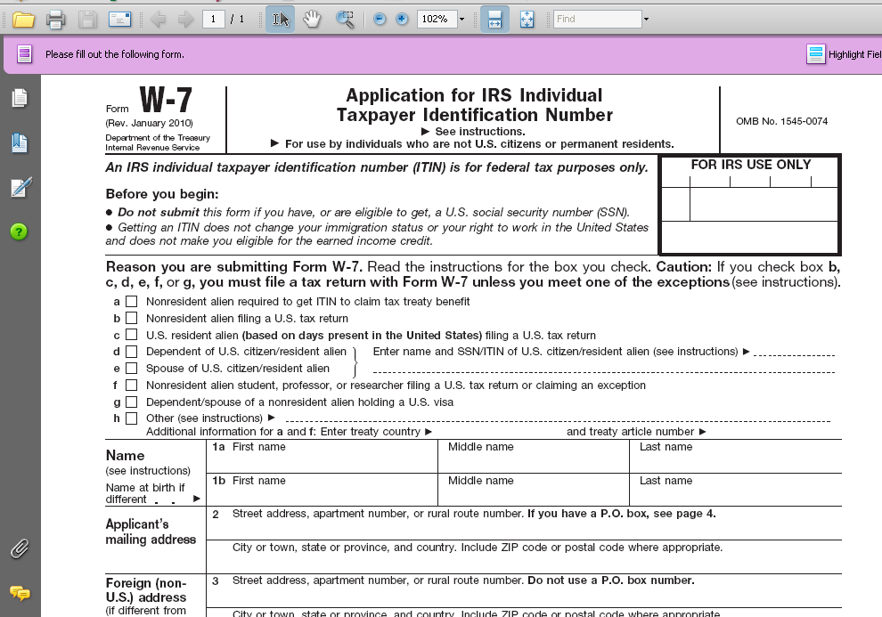

Slide 9
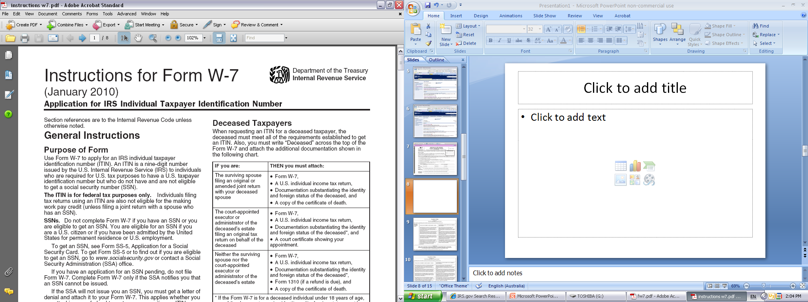

Slide 11
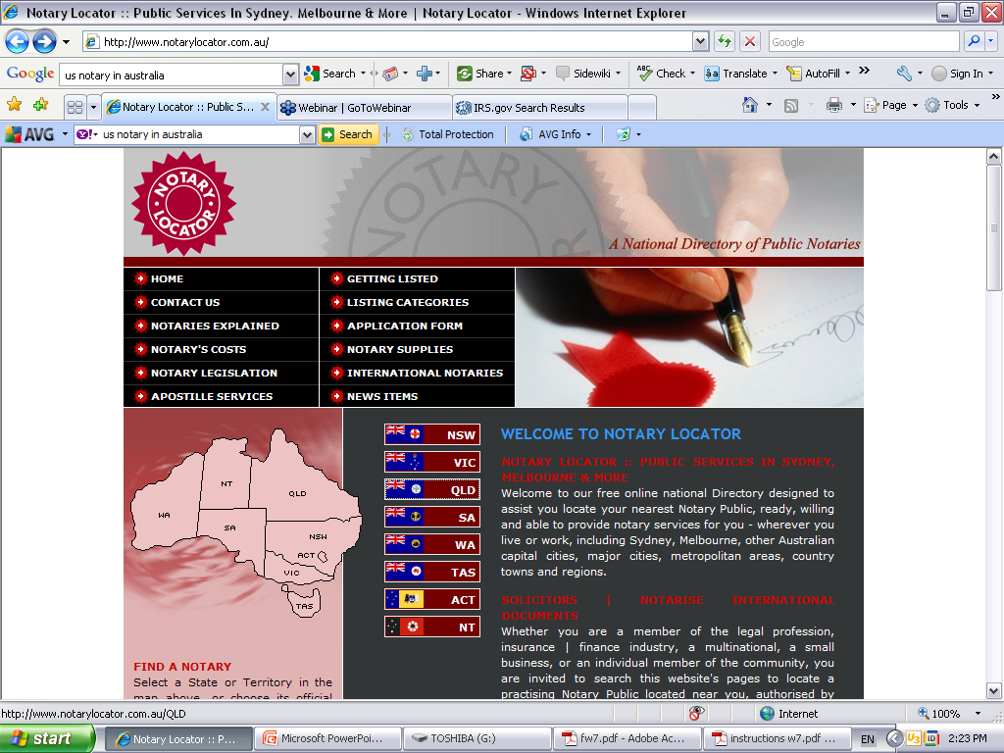

Slide 12
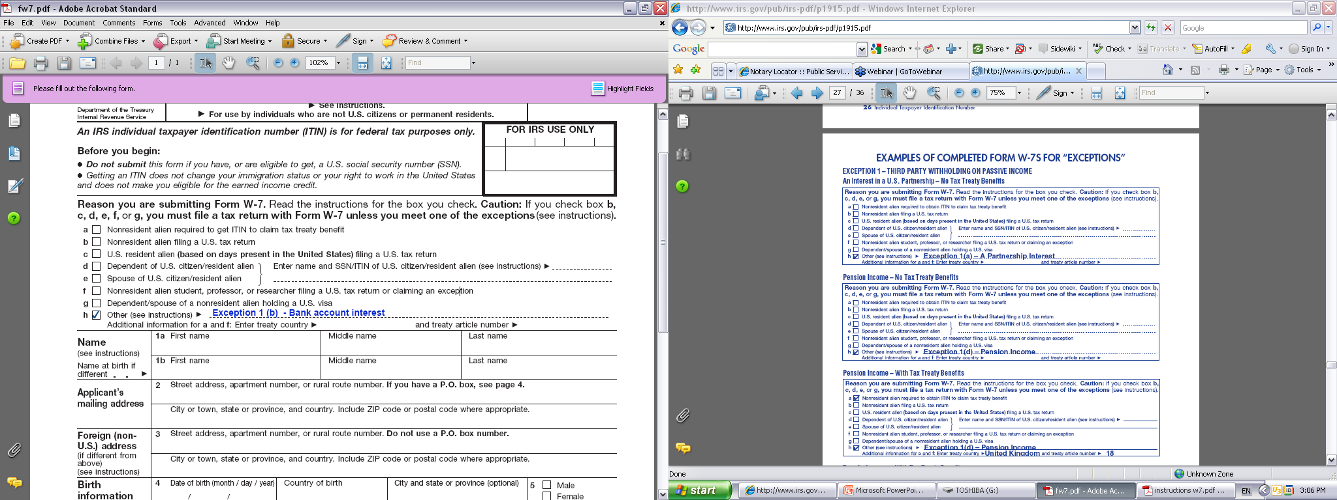

Slide 13
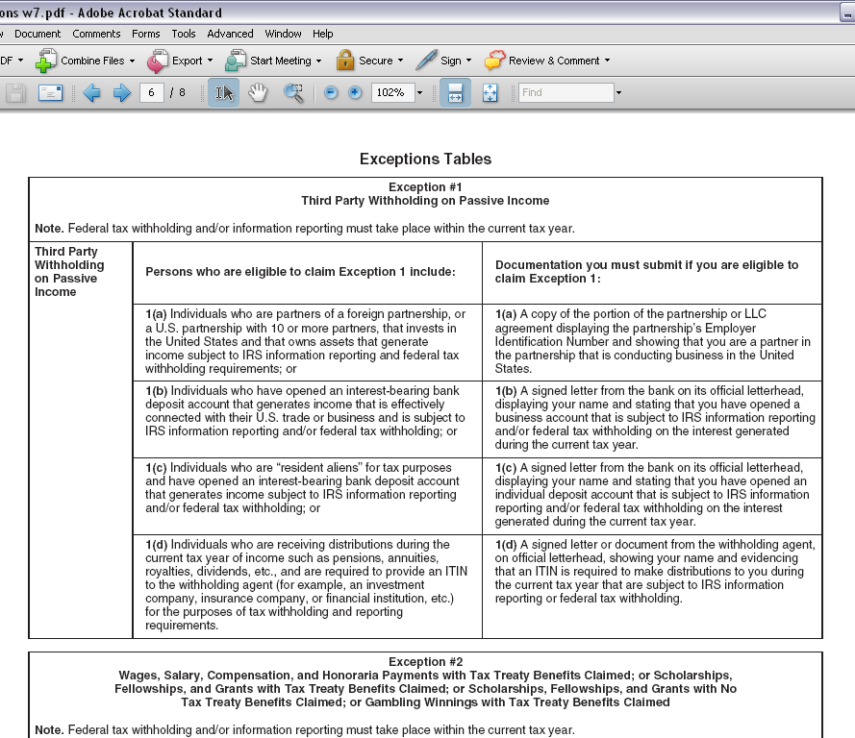

Slide 14
1(b) Individuals who have opened an interest-bearing bank deposit account that generates income that is effectively connected with their U.S. trade or business and is subject to IRS information reporting and/or federal tax withholding; or

Slide 15
Exception #1
Third Party Withholding on Passive Income
Note. Federal tax withholding and/or information reporting must take place within the current tax year.
Persons who are eligible to claim Exception 1 include:
1(b) Individuals who have opened an interest-bearing bank deposit account that generates income that is effectively connected with their U.S. trade or business and is subject to IRS information reporting and/or federal tax withholding; or

Slide 16
Documentation you must submit if you are eligible to claim Exception 1:
1(b) A signed letter from the bank on its official letterhead, displaying your name and stating that you have opened a business account that is subject to IRS information reporting and/or federal tax withholding on the interest generated during the current tax year.

Slide 17
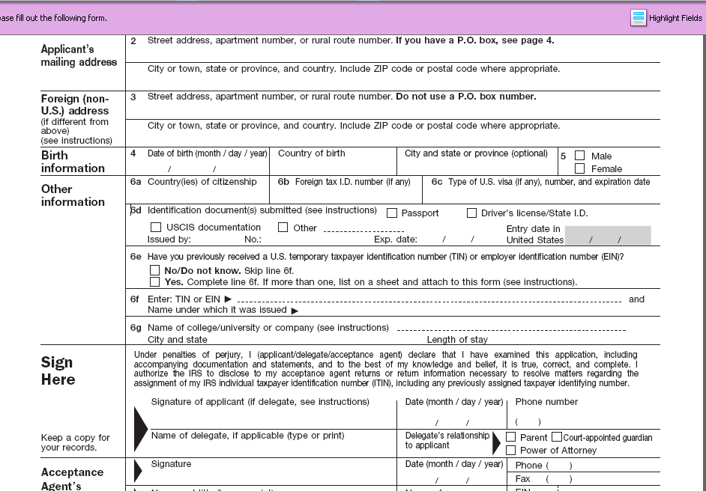

Slide 18
Additional Information
Publications. In addition to Pubs. 501, 515, and 519 mentioned earlier, see Pub. 1915, Understanding Your IRS Individual Taxpayer Identification Number (ITIN), for more information.
These publications are available free from the IRS. To order the publications, call 1-800-TAX-FORM (1-800-829-3676) if you are in the United States. If you have a foreign address, write to:
Internal Revenue Service
1201 N. Mitsubishi Motorway
Bloomington, IL 61705-6613
You also can get these publications on the IRS website at www.irs.gov.
Telephone help. If, after reading these instructions and our free publications, you are not sure how to complete your application or have additional questions, call 1-800-829-1040 if you are in the United States. If you are outside the United States, call 215-516-2000 (not a toll-free number) or contact our overseas offices in Beijing, Frankfurt, London, or Paris.

Slide 19
